Slide 1
Census Income Prediction
Team Name: Analytics
Team Members:
Kesav Adithya Venkidusamy, Meenakshi Shankara, Sherry Kosmicki
Bellevue University
DSC630-T301 Predictive Analytics (2227-1)
Professor Fadi Alsaleem
August 13, 2022
Notes:
Today we would like to present our findings in a predictive analytics project to determine income potential based on a set number of variables.

Slide 2
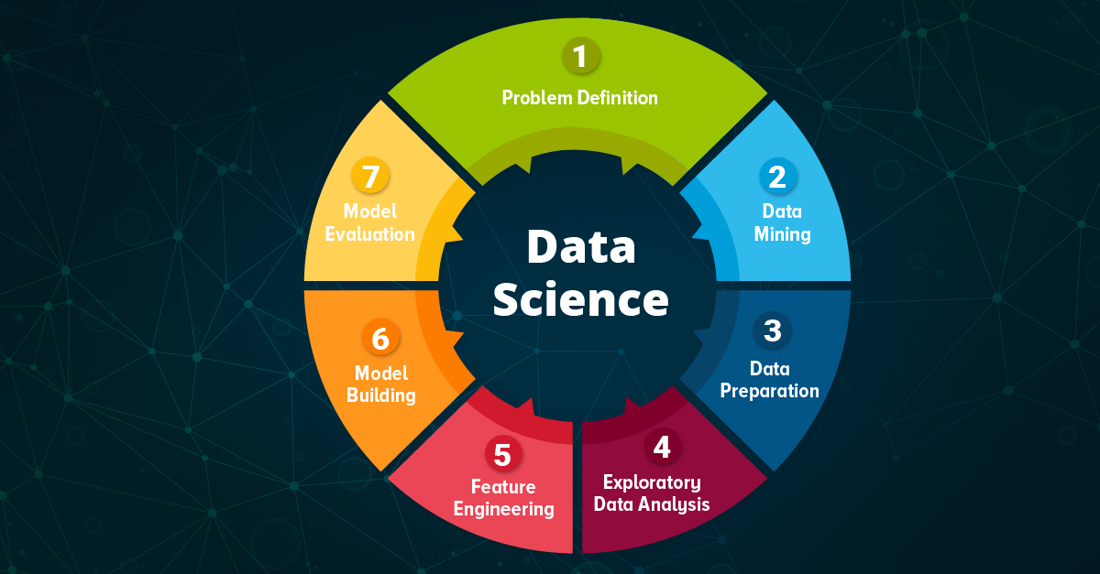
Census
Income
Prediction
Notes:
The data science life cycle represented on this slide, shows the process used to develop the data and create a model to determine our predictions. We started with the problem definition which can be the most difficult step in the project. This step is where we formulate the question we are trying to answer. Once that has been defined, we move to data mining and data preparation. In this phase we evaluate our data, make sure it meets our needs, and start the cleaning process. This phase also includes creating visualizations to show us another angle of the data and make any needed changes to prepare for modeling. Feature engineering involves scaling data so that it is represented equally for the modeling process. Next our data structure and the evaluation of visualizations will help us decide the best model to use. Once we model the data, we can then evaluate its efficiency. Depending on that outcome we may choose to reevaluate using a different model. This process continues until we have the outcomes needed to use with future data. A full evaluation of the model helps confirm our choice for our predictions.

Slide 3

Why is income prediction important?
Notes:
Why is income prediction important? Income prediction is important for a variety of areas in the private and nonprofit sectors. One critical area this affects is marketing, where income segmentation of the population is an extremely important tool. Businesses may make different variations of their items designated for certain subgroups of the population, and these subgroups often include the income of individuals. Income prediction also helps to identify those individuals who are of a lower income that may need the most assistance, who some nonprofits strive to identify and assist. The ability to predict the income of individuals from this information has far-reaching impacts for every industry.

Slide 4
Data Structure
Feature Name | Feature Description | Feature Type
age | Age of the person | Continuous
workclass | Work class of the person | Discrete
fnlwgt | Final Weight | Continuous
education | Education of the person | Discrete
education-num | Number of years the person | Continuous
marital-status | Marital status of the person | Discrete
occupation | Occupation of the person | Discrete
relationship | Relationship of the person to the family | Discrete
race | Race of the person | Discrete
sex | Sex of the person | Discrete
capital-gain | Capital Gain | Continuous
capital-loss | Capital Loss | Continuous
hours-per-week | Hour the person worked for a week | Continuous
native-country | Native country | Discrete
Income | Income of the person | Target
Notes:
The data for our project was extracted from the 1994 Census bureau database by Ronny Kohavi and Barry Becker. The problem statement of this project is to identify the dataset feature or features which are mostly related to or affecting the income of a household. With the dataset having 48,842 records, we will be able to predict an answer to our problem statement. The dataset consists of 15 features of which 6 are numerical and rest are categorical with “income” being the target. The target variable income contains 2 values. It will indicate if the individual's income is less than 50 thousand dollars per year or greater than 50 thousand dollars income per year.

Slide 5
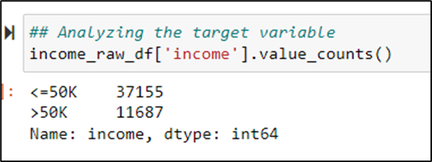
Missing Values
Feature Name | # Of missing Values | Percentage
workclass | 2799 | 5.7%
occupation | 2809 | 5.8%
native-country | 857 | 1.8%
Analyzing Income
Notes:
Among 14 features, we see missing values present only for 3 features – workclass, occupation and native-country. The percentage of missing values is represented in the top table on this slide. We noticed that the values where ‘workclass’ is missing, it also has ‘occupation’ missing. While trying to identify the extra rows where ‘occupation’ is missing, we observed the workclass is ‘Never-Worked’. Since the percentage of null values present in these features is low, we plan to replace the missing values with the value has the most representation in the column.
The income column is our target variable with 2 values - ‘<=50K’ and ‘>50K’. The count of these values is 37155 and 11687 respectively, suggesting that people with income higher than 50K are significantly less, and our data set is kind of imbalanced considering the target variable.

Slide 6
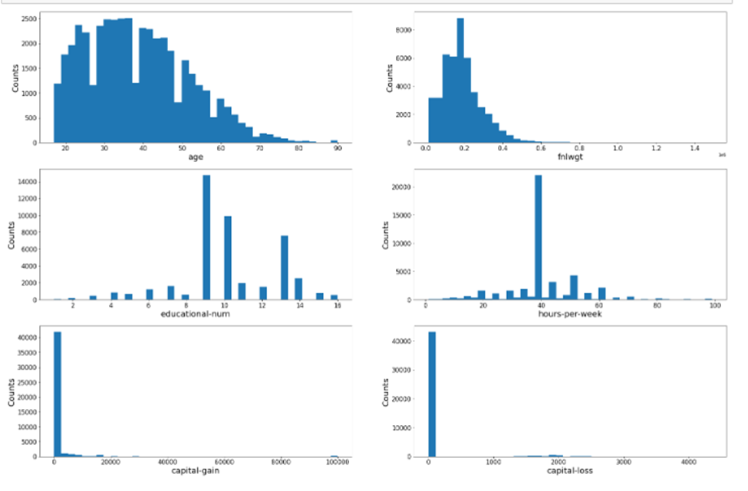
Exploratory Data Analysis
Notes:
When looking at histograms of each of the variables, the age feature is rightly skewed, with the majority of ages falling in the 20-50 years of age range. The count keeps on decreasing as the age increases. These is no null value representation in this column. The fntwgt (functional weight) feature is rightly skewed with the majority of the data between 100 thousand and 200 thousand. The count decreases as the value increases. The education num, which is a numeric representation of where the individual is in there educational status, and we see the most values at the number 9 and 10. The hours per week column has the most values at 40. The majority of the capital-gain and capital-loss variable values are zero.

Slide 7
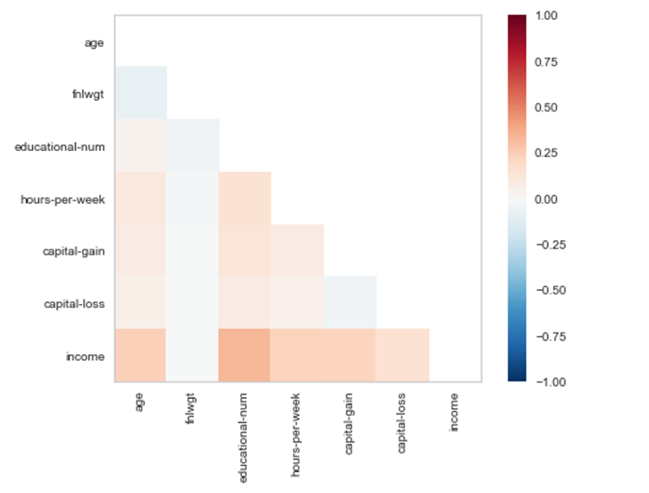
Heat Map
Notes:
A heat map has been created to understand Pearson’s correlation between the target variable ‘income’ and other numerical variables. We observed that all numerical features have positive correlation with the target except functional weight (fnlwgt) feature. Among the features having positive correlation, age and education-num features are having a high value. This is indicated by the darker shade as it moves up the scale.

Slide 8
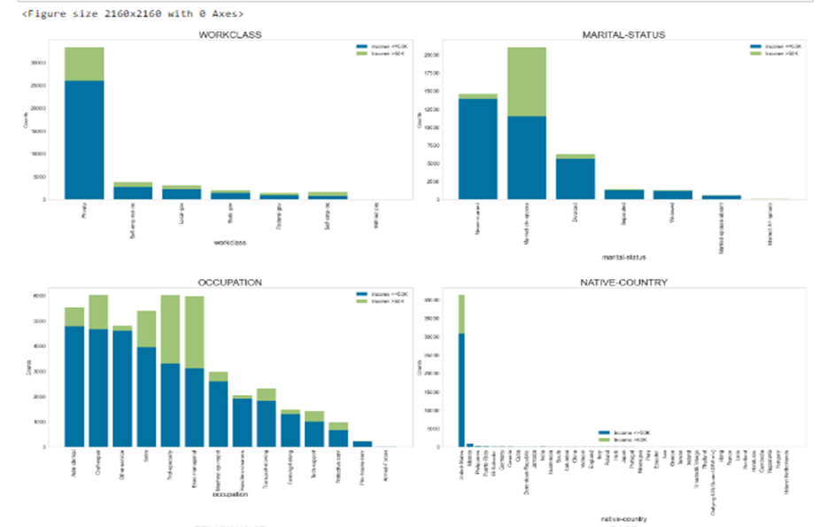
Variable values vs Income
Notes:
These visualizations were created to evaluate each variable with the addition of a comparison of the income less than or equal to 50 thousand, indicated in blue, and income more than 50 thousand, indicated in green in the bar graphs. In the workclass variable the majority of the people belong to the Private sector workclass. In this graphic, most people belong to the less than or equal to 50 thousand income status. Marital status has 7 different categories and where we see any income variance is in the Married with spouse variable. The remainder show the majority make less than 50 thousand. The occupation column contains 14 different categories. Except for a few values where the data is equally split between the income class, all other groups have a higher count for the less than or equal to 50 thousand income. The highest count in the native-country column is the United States. Income values are higher for the less than or equal to 50 thousand income category within the United States.

Slide 9
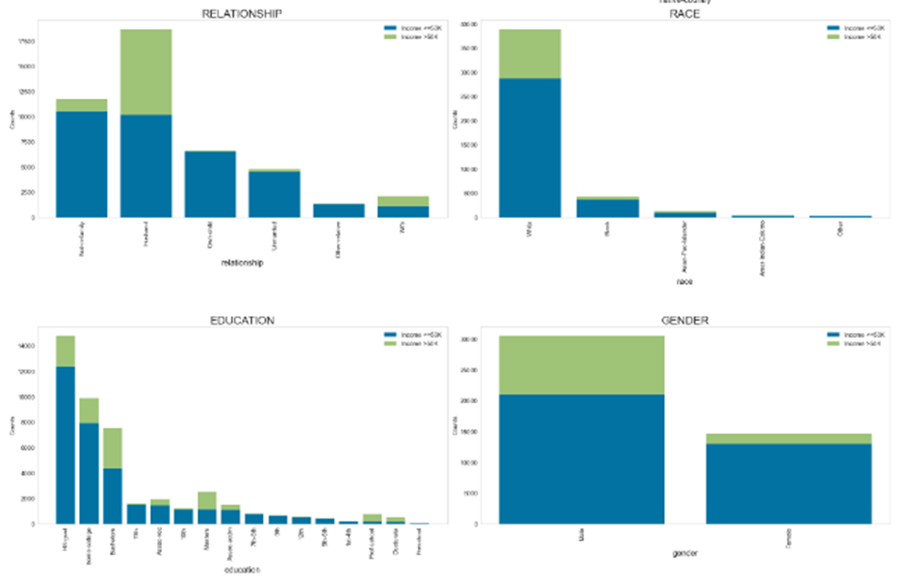
Variable Values vs Income
Notes:
The visualizations of last four variables in the two income categories, show some equal distribution in the largest value for relationship indicated as "husband". The race column has 5 different categories, and no missing data. The highest number of people have a race of white. A person has a high chance of making an income greater than 50 thousand if his or her race is white or asian pacific islander. In the education field, which was more of a categorial representation of a persons school status, people with an education level as "Masters/Doctorate/Prof-school" have higher ratios of earning greater than 50 thousand. The bachelor's degree category also shows a ratio of 10 to 7 of less than 50 thousand and greater than 50 thousand respectfully. In the gender comparison shows that males have a higher chance of earning more than 50 thousand than females.

Slide 10
Feature Engineering
The below methods were applied on the features prepping them for model building
Label Encoder
Standard Scalar
Notes:
We started by using a label encoder method for the categorical variables. After the data was split into train and test, this method was then applied to our model choices and the accuracy measurements were evaluated. We then applied a standard scaler to our train and test data and applied the same model choices. Those results helped us decide the best encoding method.

Slide 11
Model Building
Model | Definition | Pros | Cons
Logistic Regression | predicts a dependent data variable by analyzing the relationship between one or more existing independent variables | Probabilistic Approach, gives info about statistical significance of features | the assumption of linearity between the dependent variable and the independent variables
Decision Tree | a series of sequential decisions made to reach a specific result | Interpretability, no need for feature scaling, works on both linear/nonlinear problems | Poor results on small datasets, overfitting can easily occur
Random Forest | a forest of randomly created decision trees, a combined output of individual decision trees to generate the final output. | Powerful and accurate, good performance on many problems including nonlinear | No interpretability, overfitting can easily occur, need to choose the number of trees
Notes:
For this project, we built 3 models – Logistic Regression, Decision Tree, and Random Forest.
Logistic Regression predicts a dependent data variable by analyzing the relationship between one or more existing independent variables. It has a probabilistic approach and gives statistical information about the features and their significance to the prediction. The major limitation of Logistic Regression is the assumption of linearity between the dependent variable and the independent variables.
Decision Tree is a series of sequential decisions made to reach a specific result. It works for a varied range of problems including linear and nonlinear. This model may result in poor evaluation on small datasets.
Random Forest is as the name goes, a forest of randomly created decision trees, a combined output of individual decision trees to generate the final output. It is very powerful and generally has a good performance on many problems, although the number of trees need to be chosen to evaluate its efficiency.

Slide 12
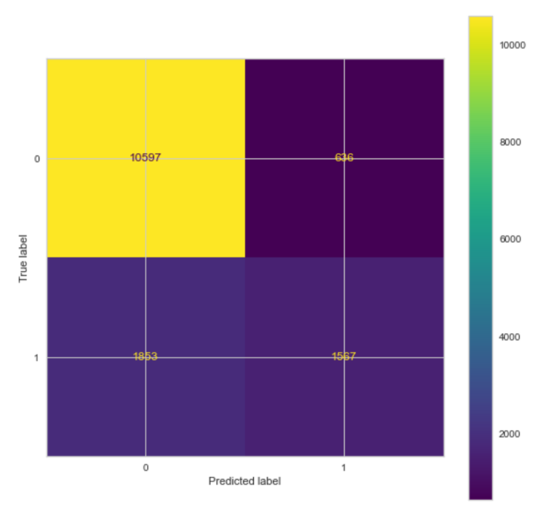
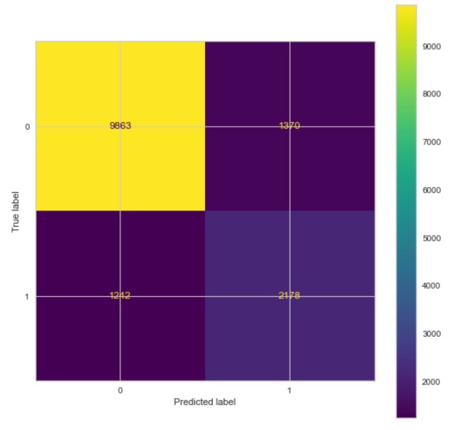
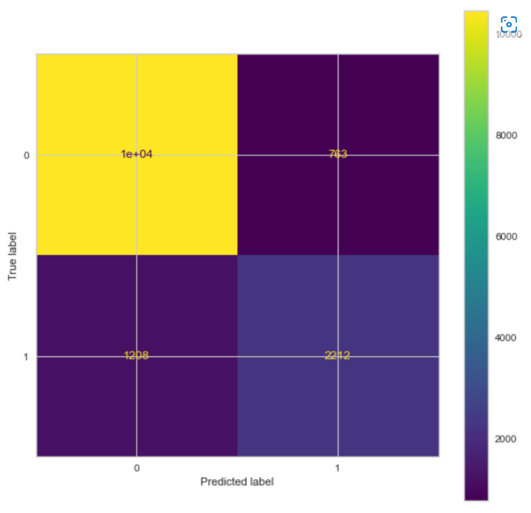
Confusion Matrix
Logistic regression
Decision Tree
Random Forest
Notes:
From the confusion matrix we can see, that the accuracy for the Logistic regression was 83%. Although there was a high level of predicting incomes below 50K, the prediction on incomes above 50K was not enough as the false negatives seem to be higher.
The accuracy score for Decision Tree model came to 82% which is a slight reduction that the Logistic Regression model. We observe that the model did seem to improve the predictions for income >50K but degraded in predicting incomes < 50K.
The accuracy score for Random Forest model was observed to be at about 87% which is the highest so far.
Please note that the above-mentioned models were evaluated considering various combinations of standardizing, feature removal.
After multiple evaluations we have decided to consider all the 14 features and encode the dataset before splitting into train and test sets and then standardizing for predicting if the income would be under or over 50K.

Slide 13
Model Efficiency Measures
Accuracy - Accuracy represents the number of correctly classified data instance over the total number of data instances
F1 Score: F1-Score is a metric which takes both precision and recall into account.
Precision: Positive predictive value
Recall: true positive rate
AUC Score: What area under the ROC curve describes good discrimination? We will use the following rule of thumb
0.5: This suggests no discrimination, so we might as well flip coin
0.5-0.7: We consider this as poor discrimination, not much better than a coin toss
0.7-0.8: Acceptable discrimination
0.8-0.9: Excellent discrimination
>0.9: Outstanding discrimination

Slide 14
Model Efficiency (All Features)
Model | Standard Scalar | Accuracy | F1 Score (Income <=50K) | F1 Score (Income >50K) | AUC Score
Logistic Regression | No | 79.80% | 0.88 | 0.4 | 0.74
 | Yes | 83.01% | 0.89 | 0.56
Decision Tree | No | 82.14% | 0.88 | 0.62 | 0.76
 | Yes | 82.17% | 0.88 | 0.63
Random Forest | No | 86.55% | 0.91 | 0.69 | 0.91
 | Yes | 86.54% | 0.91 | 0.69
Notes:
Initially, all three algorithms (logistic regression, decision tree and random forest) have been applied on the dataset containing all 14 features. We see random forest gives the highest score of 86.55% compared to other 2 models. Then, we applied Standardscalar on the dataset and applied all three models again. We see slight improvement in score for logistic regression. However, decision tree and random forest gives the more or less the same score.

Slide 15
Model Efficiency (With 11 Features)
Model | StandardScalar | Accuracy | F1 Score (Income <=50K) | F1 Score (Income >50K) | AUC Score
Logistic Regression | No | 80.74% | 0.88 | 0.49 | 0.81
 | Yes | 81.07% | 0.88 | 0.5
Decision Tree | No | 78.44% | 0.86 | 0.53 | 0.72
 | Yes | 78.44% | 0.86 | 0.53
Random Forest | No | 82.32% | 0.89 | 0.6 | 0.87
 | Yes | 82.18% | 0.89 | 0.6
Notes:
As a next step, we removed all unwanted features from the dataset and applied all three models on the dataset with 11 features. In this trial also, we see random forest gives the highest score of 82.32% compared to other 2 models. We applying Standardscalar on the dataset and ran all three models again. We don't see much improvement to the score. We also noticed that score for all three models has been reduced compared to running these models on the dataset with all features.

Slide 16
Model Efficiency (5 Best Features)
Model | Accuracy | F1 Score (Income <=50K) | F1 Score (Income >50K) | AUC Score
Logistic Regression | 79.99% | 0.88 | 0.48 | 0.81
Decision Tree | 79.56% | 0.87 | 0.54 | 0.77
Random Forest | 80.86% | 0.88 | 0.57 | 0.85
Notes:
Using SelectKBest, we tried to find the 5 best features after removing unwanted features from the dataset, and following are the best features in the dataset which shows higher impact to the target variable “income” compared to other features present in the dataset.
Age, Education-num, Marital-Status, Relationship, Hours-per-week
Upon running all three models on the dataset with top 5 best features, the score turned out as 79.99%, 79.5% and 80.86% respectively. The corresponding AUC scores are 0.81, 0.77 and 0.85 respectively.

Slide 17
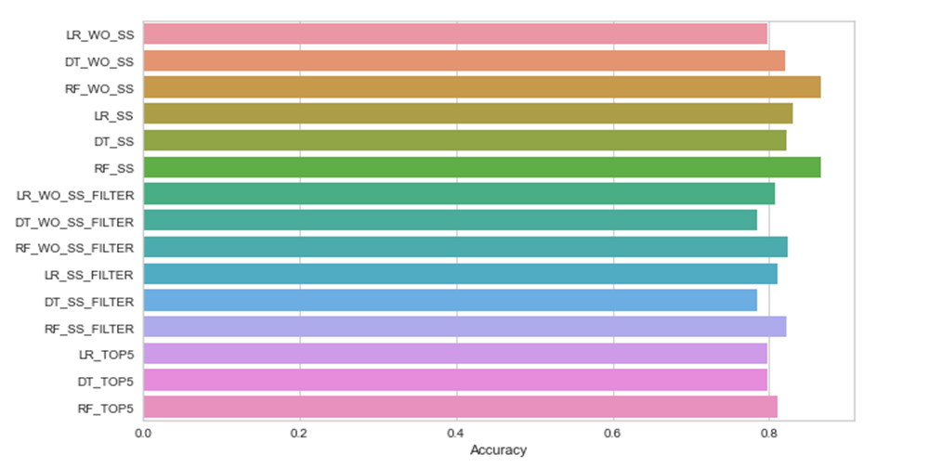
Model Efficiency Score Chart
Notes:
Chart showing the scores of different approaches we have taken. Among all Random forest applied on the dataset with all features gives the highest score.

Slide 18
Observations
Best
Performing
Features
Pearson's correlation matrix Feature correlation to target variable "income"
Chi-Squared (X2) Test 5 Best features correlated to "Income"
Using Feature Importance of Random Forest Classifier
Notes:
Observations were made to determine the best performing features. We used the Pearson's correlation matrix, Chi-Squared Test, and feature importance of the random forest classifier to make these determinations. Each one is explained in greater detail on the next three slides.

Slide 19

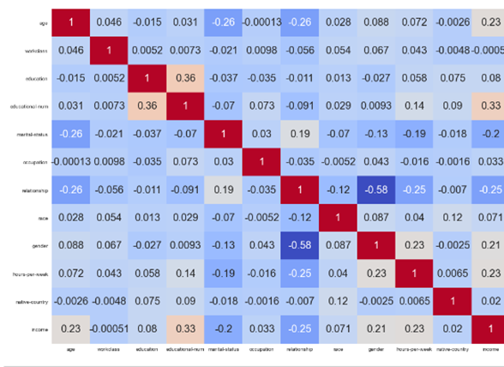
Pearson's Correlation Matrix
Numerical Variables: ​ Age​ Education-num​ Hours-per-week​ ​ Categorical Variables:​ Gender​ Education​
Notes:
The Pearson's correlation matrix does a comparison of the variables to our target variable income. The darker the blue in this visualization shows a positive correlation with the target and any box shaded lighter or more of a pink color would indicate a less correlation and even a negative correlation. The numerical variables that are correlated most with income determination are age, education-num, and hours-per-week. The categorical variables that relate to income are gender and education.

Slide 20
Chi-Squared (X2) Test - 5 Best features
Relationship
education-num
Age
marital-status
hours-per-week
Notes:
Another method to test the dependency of a variable on the target variable is to do a Chi-squared test. With this method we were able to determine that relationship, education-num, age, marital-status, and hours-per-week were the best features.

Slide 21
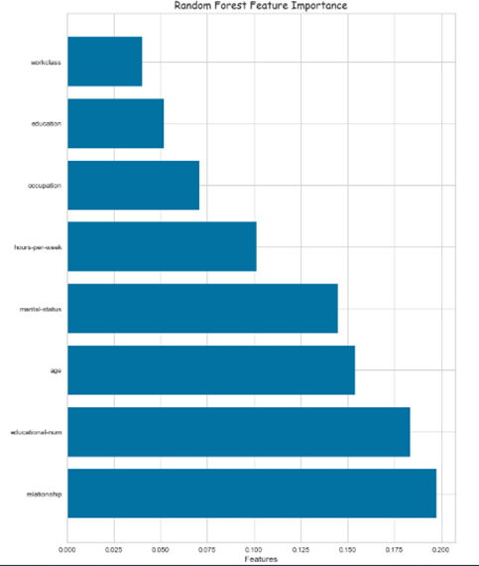
Feature Importance of Random Forest Classifier
Relationship
education-num
Age
marital-status
hours-per-week
Notes:
Our last method of determining features of importance was the random forest classifier. The random forest classifier gave us the best results for modeling. This modeling method has a feature to assign an importance value to each variable based on a majority calculation. This method shows relationship, education-num, age, marital-status and hours-per-week with the greatest value of importance.

Slide 22
Findings and Recommendations
Random Forest Classifier
Features having high impact on the target variable “income”
Relationship: Relationship of the person to the family
Education-num: Number of years the person had education
Age: Age of the person
Marital-status: Marital status of the person
Hours-per-week: Hour the person worked for a week
Notes:
Out of three models, Random Forest Classifier is the best model to predict the income of a household. The accuracy score is higher compared to Logistic Regression and Decision Tree Classifier when we try to run the model for different scenarios.
Among various methods used to find 5 best features in the dataset, when looking at all the methods from the previous slides, we determine age, education-num and hours-per-week are the best features and have high impact on the target variable “income” compared to other features in the dataset. Pearson’s correlation gave Gender and Education as the next best features, while chi-squared and feature importance of random forest gave relationship and marital-status as best features having a high impact.

Slide 23
Findings and Recommendations
Recommendations for earning an income higher than 50K:
You should work more hours per week to earn more income (Example: one who works 80 hours earn more compared to the one who works only 40 hours)
You should study for a greater number of years (number of education years) to earn high income.
The model also predicted that married persons earn more compared to unmarried persons. This may be because a person with more experience (in term of years) is earning more compared to freshers. Mostly, the persons with more experience are married.
The model predicts that older people earn more compared to younger people. This implies that older people would have more experience who in turn earn more. So, as you get older, you will likely earn more income.
Notes:
Our final recommendations are related specifically the factors involved when determining if a person will earn more than 50 thousand dollars per year. They are as follows: You should work more hours per week to earn more income, you should extend your education opportunities to earn a higher income. The model predicted that married persons are more likely to earn more compared to unmarried persons. It also identified the persons with more years of experience tend to be married. And lastly, the model determined that older people earn more compared to the younger generation. As you get older, you will likely earn more income.

Slide 24
References
Abbott, D. (2014). Applied Predictive Analytics: Principles and Techniques for the Professional Data Analyst. John Wiley & Sons, Inc.
https://www.census.gov/en.html
https://www.kaggle.com/datasets/uciml/adult-census-income
https://www.techtarget.com/searchbusinessanalytics/definition/logistic-regression
https://support.minitab.com/en-us/minitab-express/1/help-and-how-to/modeling-statistics/regression/how-to/binary-logistic-regression/before-you-start/data-considerations/

